Slide 1
Vending Machine(Mealy)
Digital LOGIC DESIGN (EE-221) BEE-13D
28th december

Slide 2
Group compostion
Name | Reg.No
Aazmir Ahmed Bhatti | 366399
Abdur Rahim Muhammad Ghani | 369247
Waleed Amir | 365843

Slide 3
Work Contribution
Aazmir Bhatti
Report, Presentation
Abdur Rahim
Proteus
Hardware: Decoders,4-bit Adders,Jk flip flop
Waleed Amir
4-bit adder, decoder
7-Segment display, State diagrams.
Currency state diagram

Slide 4
Abstract
The vending machine is an automated machine that dispenses various products such as snacks, Beverages etc to customers when money is inserted.There are 2 different types of state machines, Moore and Mealy. Our project focuses on Mealy machine. In mealy machine, the outputs are a function of the present state and the current inputs.
The aim of this project is to design a vending machine that can dispense four different products with different prices with a few additional features such as displaying the change received. The machine accepts coins of denominations 10Rs, 20Rs and 50Rs.
The modelling of this Vending machine will help in reducing the required hardware and build a more efficient & cost friendly product.

Slide 5
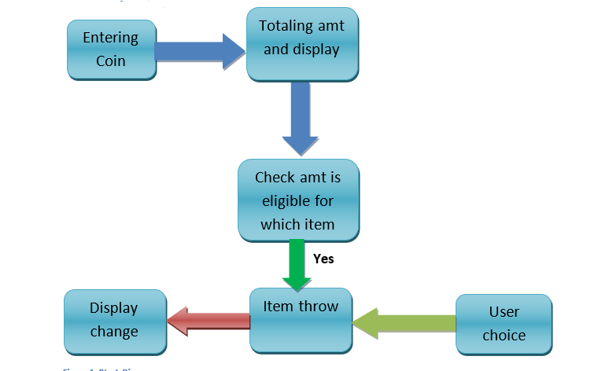
Block Diagram

Slide 6
Project Specifications
Objective : Design and implementation of a mealy vending machine.
Scope :
design and implementation of the karnaugh maps equations for the vending machine.
vending machine will be controlled by a circuitry mainly comprising of logic gates and flip flops.
will have a user interface consisting of buttons for selecting the type of item and a display for displaying the change

Slide 7
Project Specifications
Deliverables :
Electrical circuits and schematics for the vending machine.
Equations derived from Karnaugh maps.
Assembled vending machine circuitry.
Requirements:
Have input buttons for selecting the type of item and inputting a specific type of currency.
display for displaying the available options.
Be able to accept only 3 types of coins as payment
Constraints :
Budget
Time

Slide 8
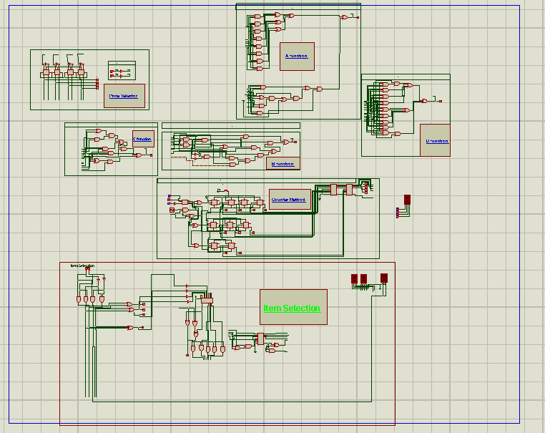

Slide 9
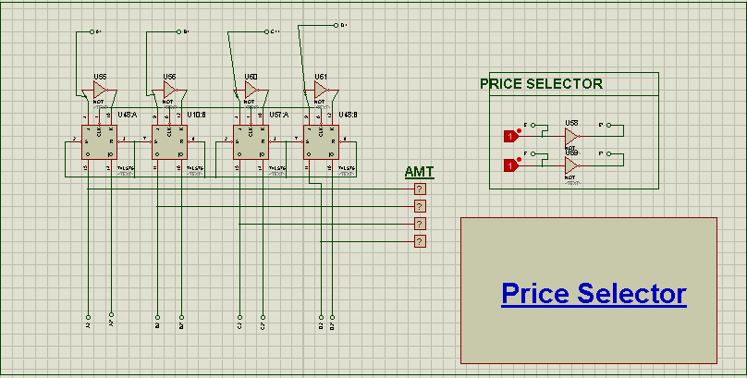

Slide 10
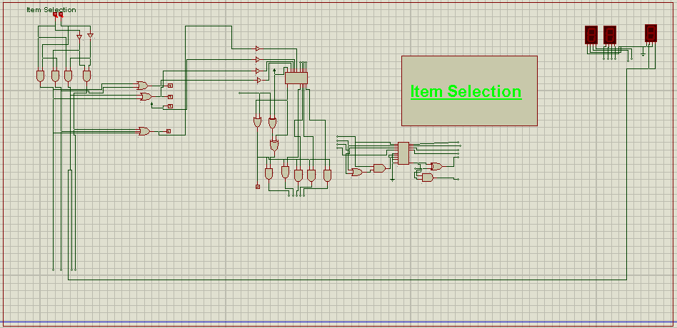

Slide 11
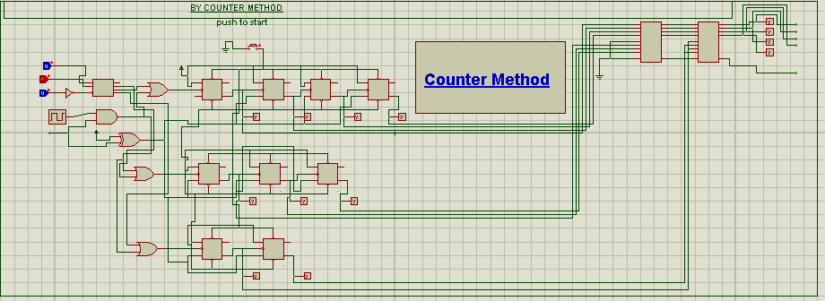

Slide 12
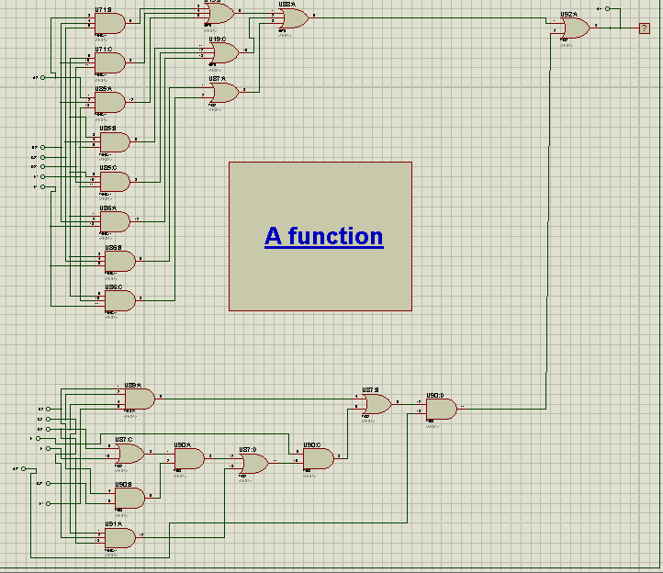

Slide 13
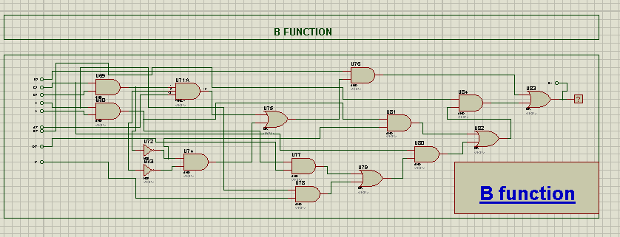

Slide 14
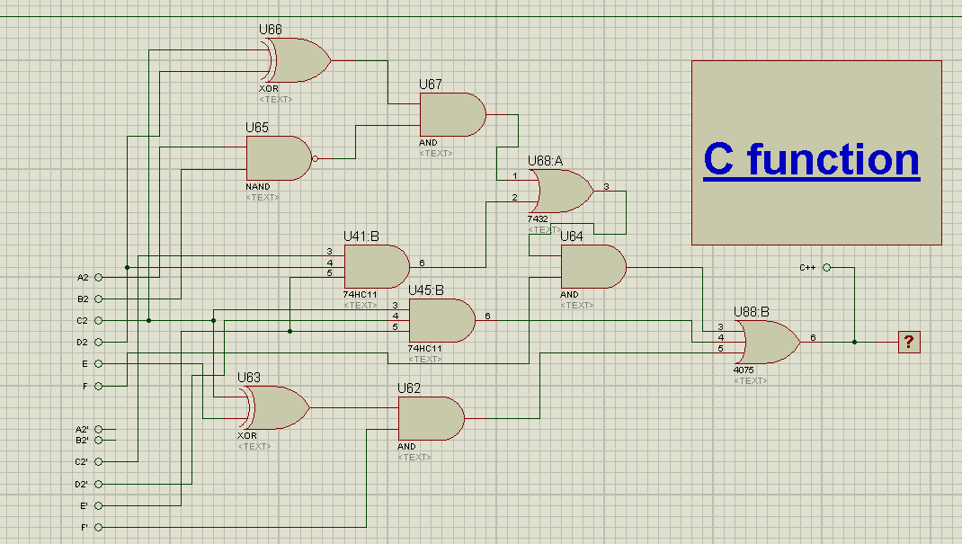

Slide 15
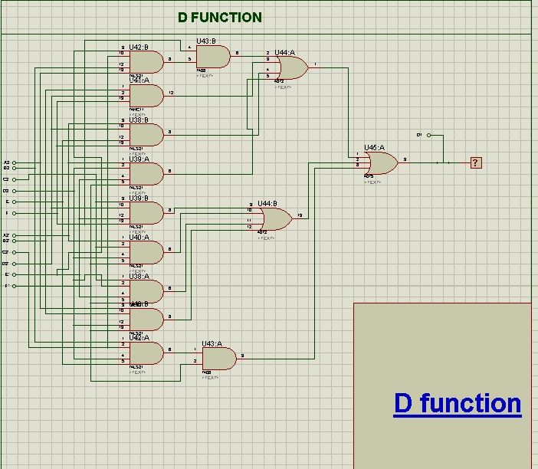

Slide 16
Design steps followed
Identify Inputs and outputs.
Define Desired Behaviour
Create state diagram
Use K-maps to simplify logic expressions
Implement logic circuit
Integrate with other components

Slide 17
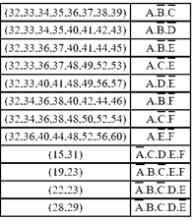
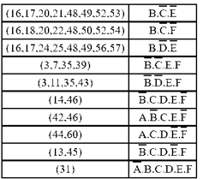
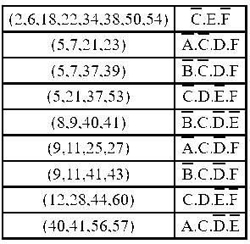
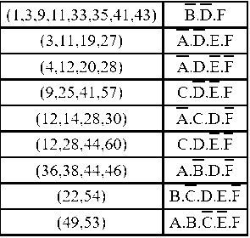
K-Maps

Slide 18
Project functionality
Accepts payment
Returns change
Can select upto 4 items priced at 30, 65, 100 and 150Rs.
3 types of currency 10,20 and 50 Rs.

Slide 19
Problems faced
Limited currency higher price range problems.
Manufacturing defects in IC’s
Power supply issues, if power is unstable can cause problems with IC.
Thermal issues : IC’s generate alot of heat when operational which can lead to overheating.
Aging : IC’s degrade

Slide 20
Future work
More states
Greater number of items
More forms of currency
Implement with real coins

Slide 21
Hardware summary
Xor Gates
2,3,4 Input OR gates
2,3,4 input AND gates
Jk flip flops
2 input NOT gates

Slide 22
Proteus
END

